Slide 1
Question 1

Slide 2
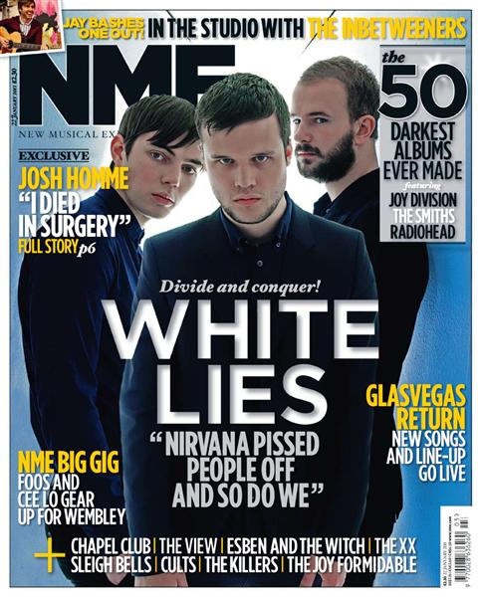
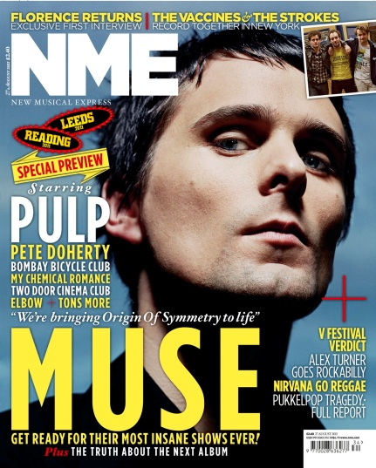
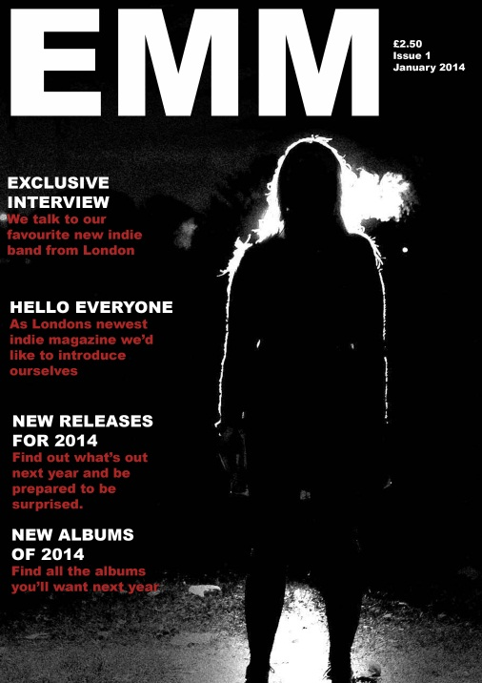
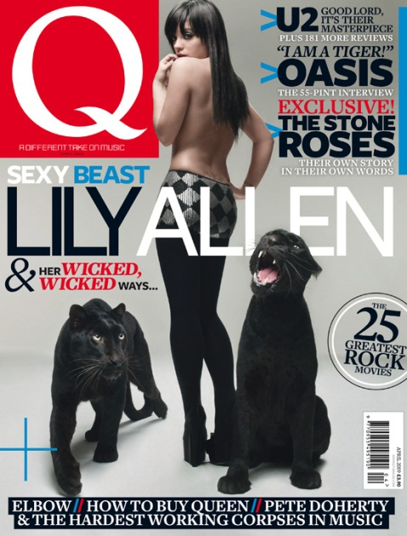
My magazine doesn’t look too out of place when compared to real publications. This may just be because it’s mine but other people have commented on it saying that it looks professional.
This is mostly because of the high quality of photography used in my magazine cover. I have also followed other conventions of magazines such as the left thirds rule, which exists because of the way magazines are stacked in shops with half the cover hidden by another magazine.
What haven’t done is I haven’t used bright colors to attract audiences as I wanted a dark, mysterious look to it. I also haven’t put on any smaller coverlines as I ran out of ideas pretty quickly.

Slide 3
Slightly more in depth “analysis” of some conventions used in popular music magazines
High quality photography
Many coverlines
Special features
Contrasting colors
Bands that everyone knows
Main picture relates to main coverline

Slide 4
How my magazine follows those conventions
High quality photography
Main picture relates to main coverline
Special features
My magazine does not follow all of the conventions that NME used. Mostly the use of many coverlines and many contrasting colors. Although red and black are quite contrasting those are the only colors used

Slide 5
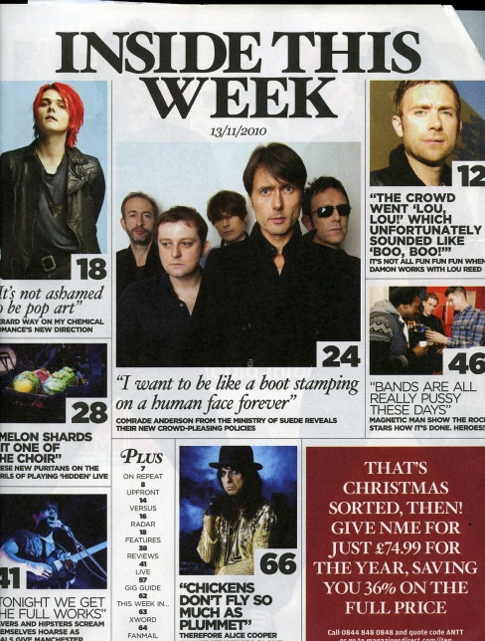
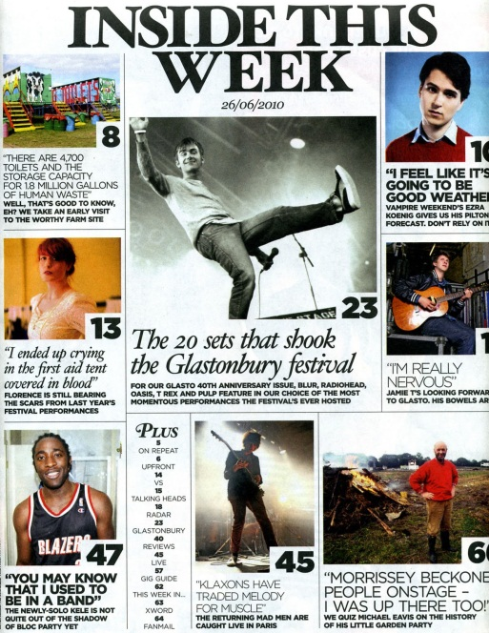
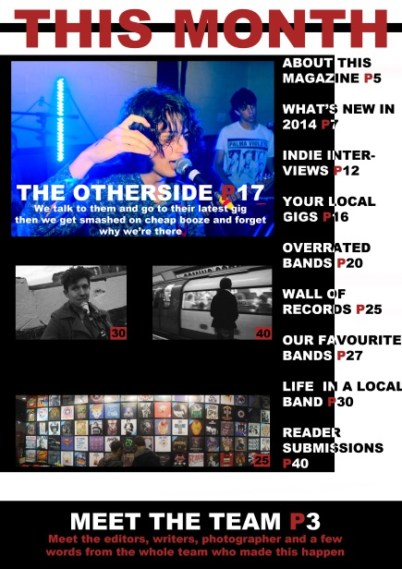
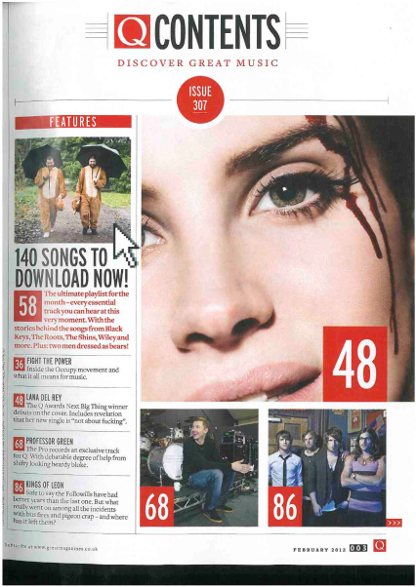
My contents page doesn’t look as professional as the ones from other major publications as I did not put in as many articles into my magazine as they did. Apart from that I followed the conventions set out by them and I tried to emulate the style of popular magazines to get a professional look

Slide 6
Analysis of conventions used by other major publications
Label of the fact that this is the contents page
Pictures with page numbers on them, for simpler navigation
Title of article and what the article is about
Pictures that relate to the main cover of the magazine

Slide 7
How I followed those conventions
Pictures that relate to articles
Page numbers
Label of the contents page
How I didn’t follow the conventions
No description of articles

Slide 8
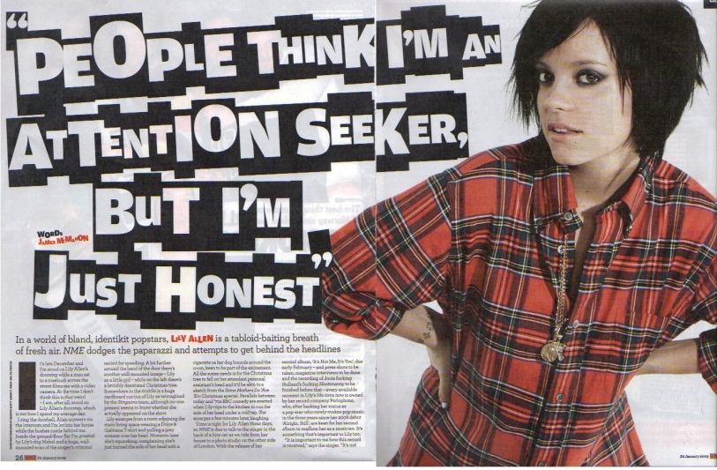
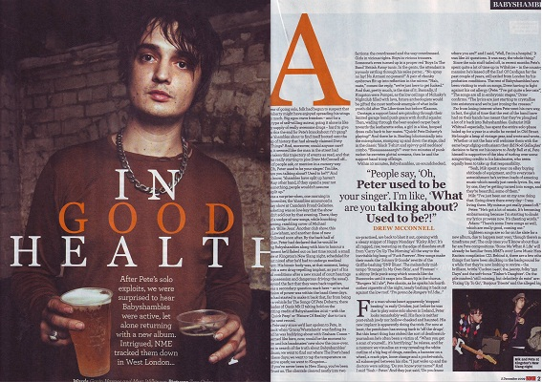
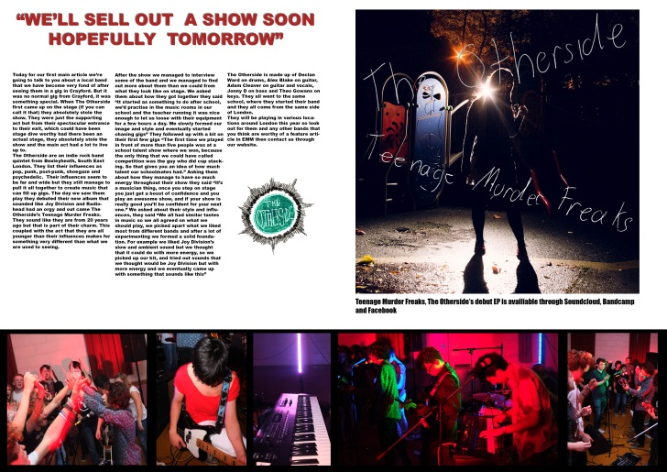
I tried to make my double page spread to look like it would belong with these professional publications.

Slide 9
Double page spread conventions
Big picture to attract attention
Quote or title of article
Text (obviously)
Small description of article

Slide 10
How I followed those conventions
Big picture to attract attention
Quote or title of article
Text (obviously)
I don’t have:
Small description of article

Slide 11
What my audience thinks:
Most of the people who have seen my magazine and are the target demographic for it say that my magazine looks like something that would belong in a shop and that it looks professional, that could be because I followed most of the conventions of magazine design.

