Slide 1
Question 3

Slide 2
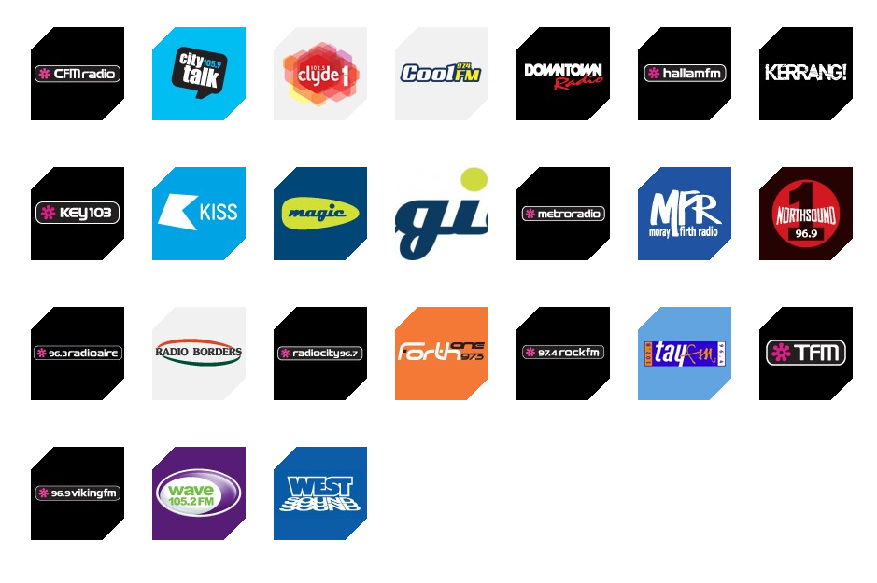
Bauer music brands
All of the music magazines that Bauer publish are local radio, which my magazine is not.
So I would not be able to go with Bauer.

Slide 3
IPC Media
The only two music magazines that IPC publish are NME and Uncut, which are both very popular and focused on rock. Which my magazine also happens to be focused on rock. My magazine would fit into their portfolio nicely

Slide 4
Hearst
All of their magazines are for women and they have no music magazines
Mine would not fit into their portfolio and market, so they wouldn’t publish mine

Slide 5
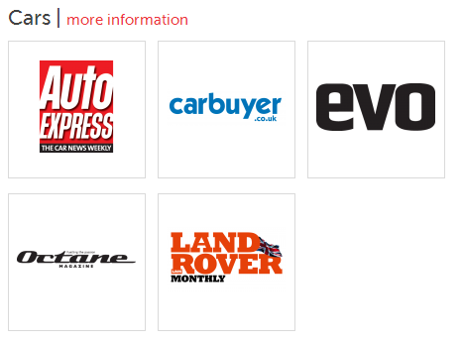
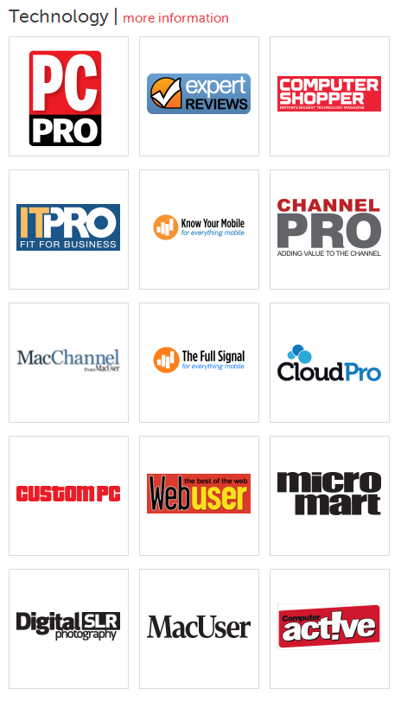
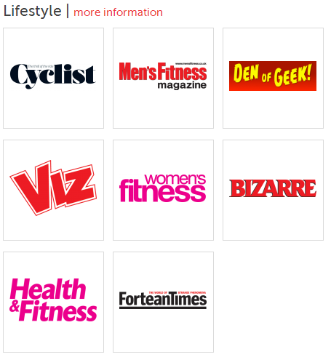
Dennis
They have three types of magazines they publish, car magazines, technology and lifestyle. They do not have many music magazines and I do not think they would publish mine

Slide 6
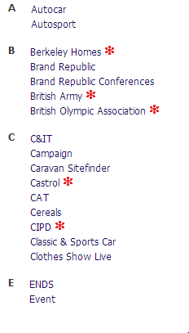
Haymarket
They do not publish and music magazines but instead focus on cars and technology. Mine would not fit in and would not be published.

Slide 7
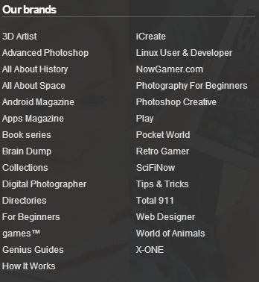
Imagine Publishing
They mostly publish magazines about technology and a few car magazines. They would most likely not publish mine.

Slide 8
Who would I go with?
IPC Media would most likely be the one out of this list to publish a magazine like mine.

