Slide 1
Question 5

Slide 2
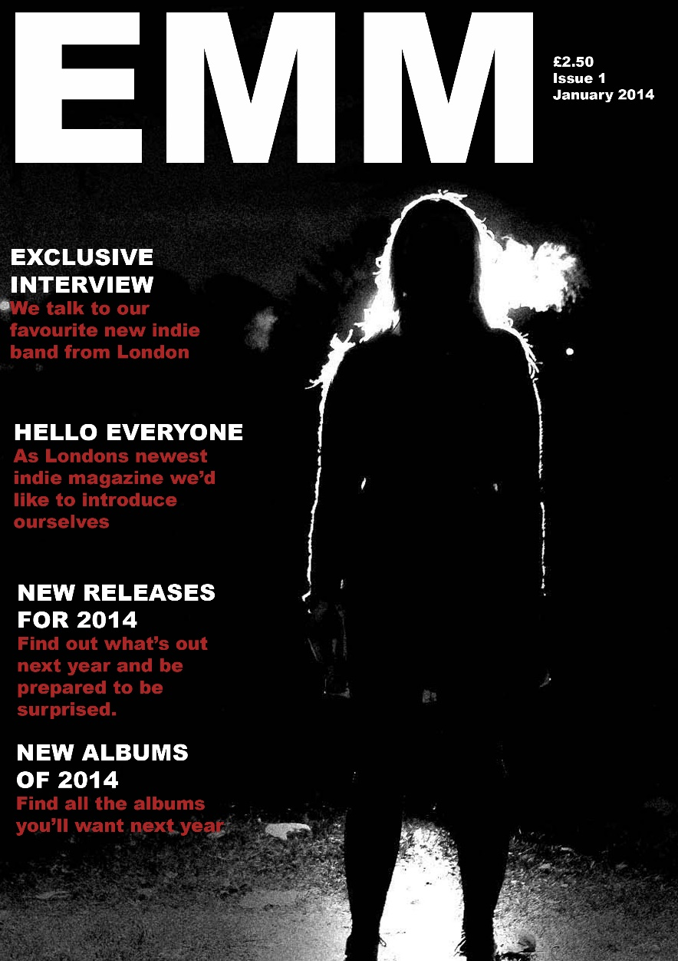
How I attracted my audience
The front cover is mostly responsible for attracting readers
By saying it is a new magazine that would interest people into buying it and seeing if it’s any good.
I made it look dark and mysterious. That could attract readers.

Slide 3
How I addressed my audience
The “hello everyone” which addresses first time readers, which would be everyone as it is a new magazine.
That article would have a personal message from the writer to the readers.

Slide 4
Audience feedback
Having shown people the magazine and the inclusion of a “meet the team” segment most of them said that they feel that it is something they would read as it would feel as if the writers cared about people who buy the magazine. I had suggestions that a message from the writers every issue would be a good idea.

